Slide 1
Some papers
(I’m on or wrote)
GVL Lab Meeting
03 February 2021

Slide 2
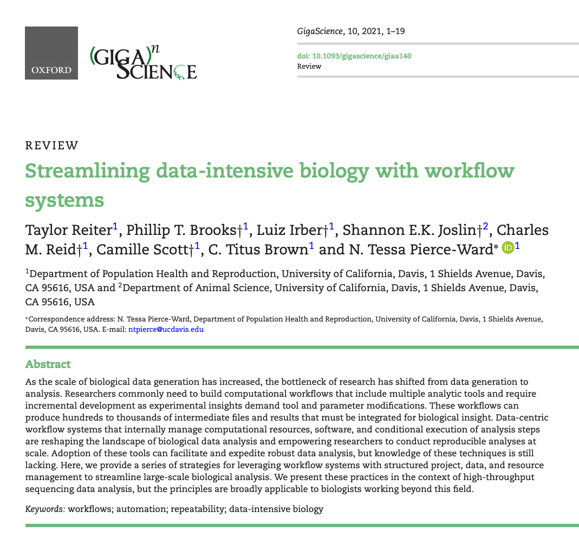

Slide 3
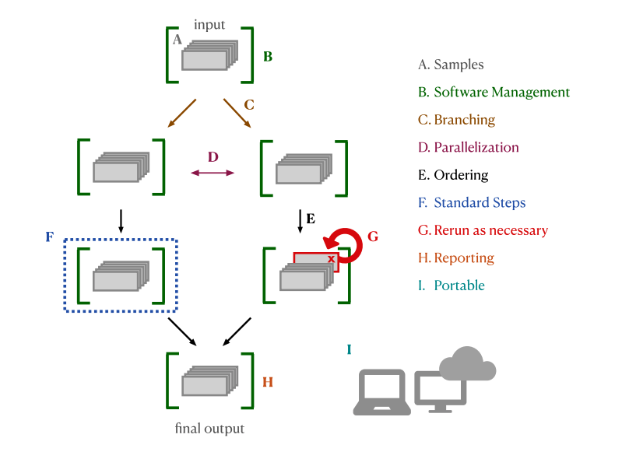
Example workflow

Slide 4
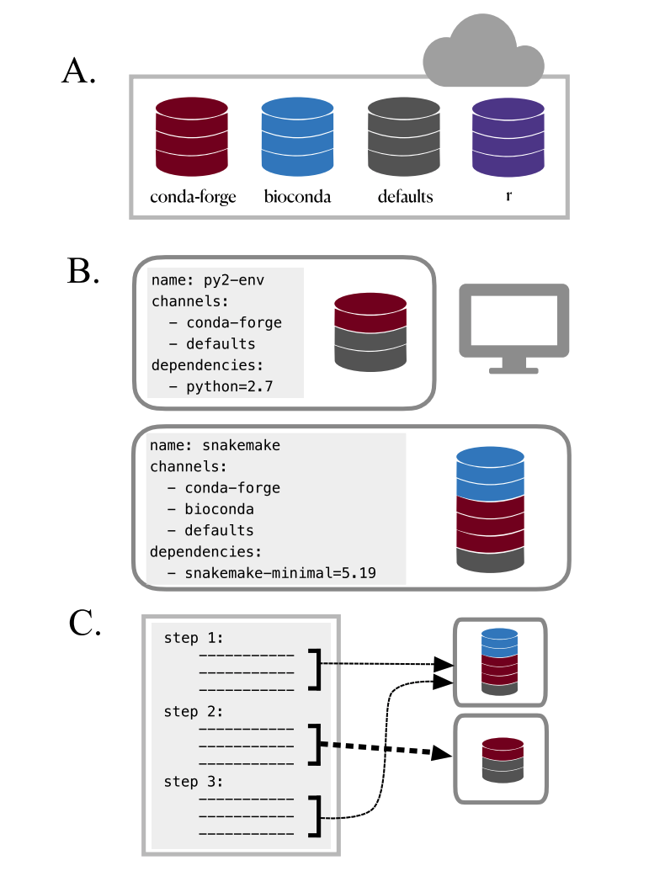
Conda

Slide 5
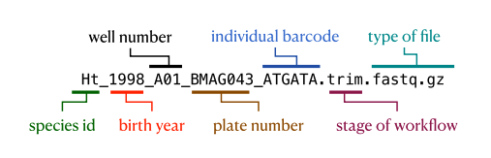
Organization

Slide 6
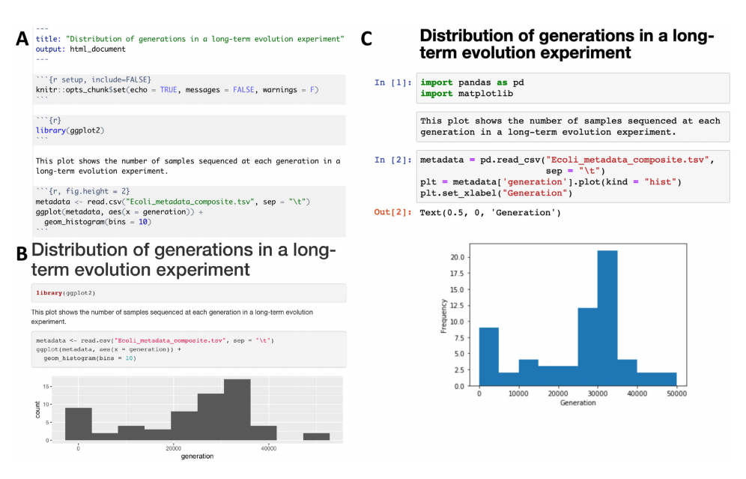
Computational Notebooks

Slide 7
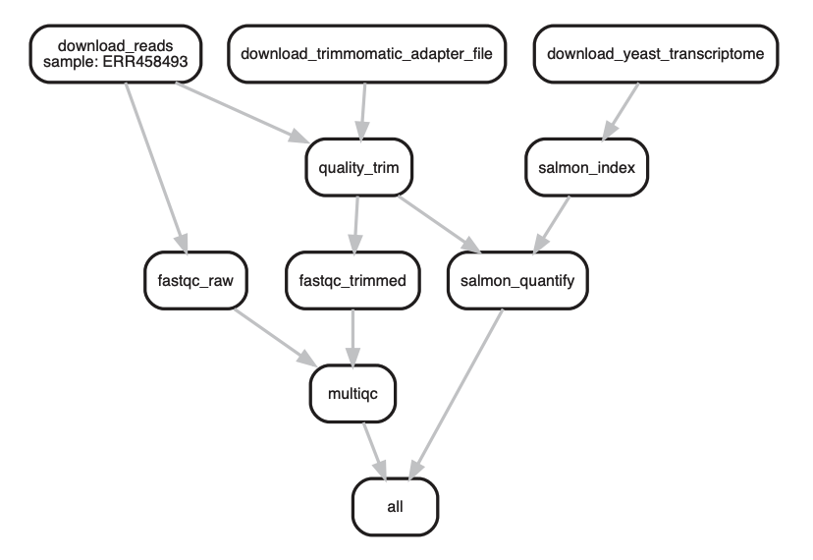
Snakemake

Slide 8
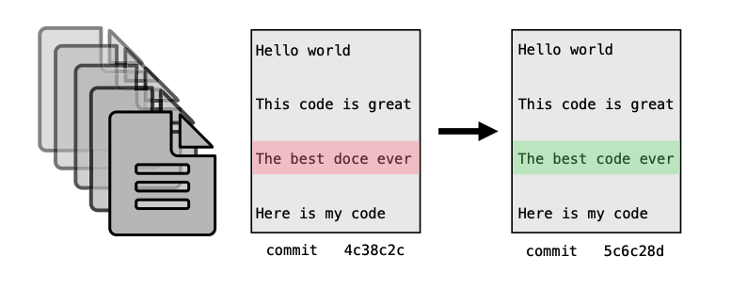
Version control

Slide 9
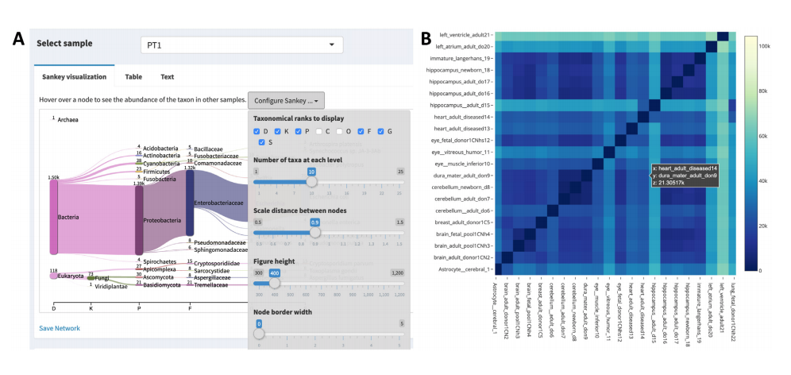
Visualization––shiny!

Slide 10
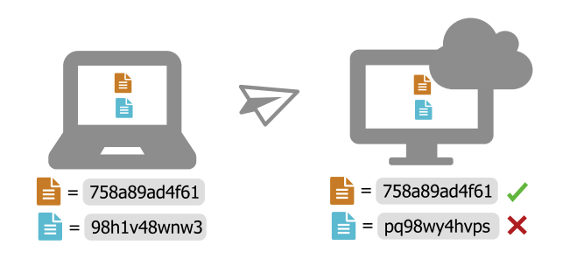
Checksums

Slide 11
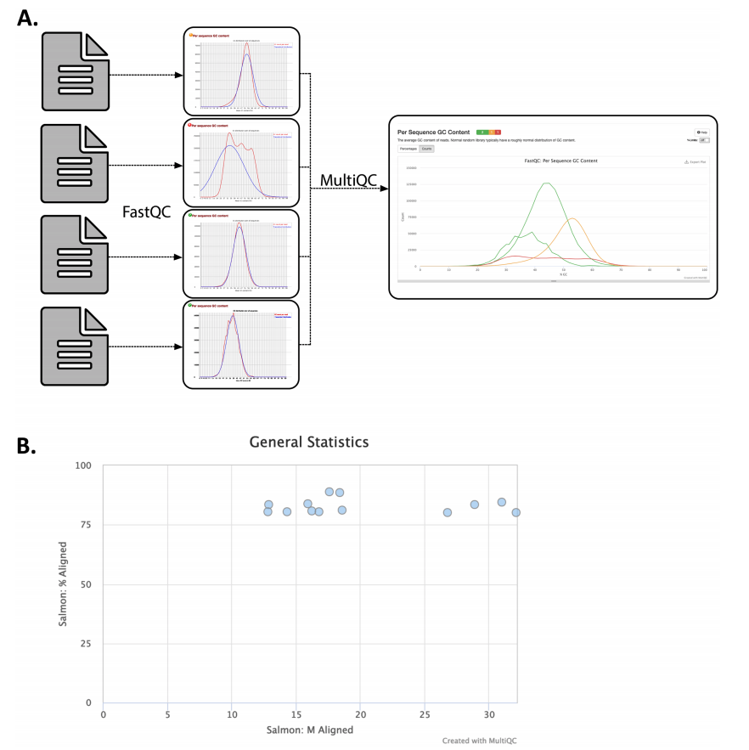
Data checks

Slide 12
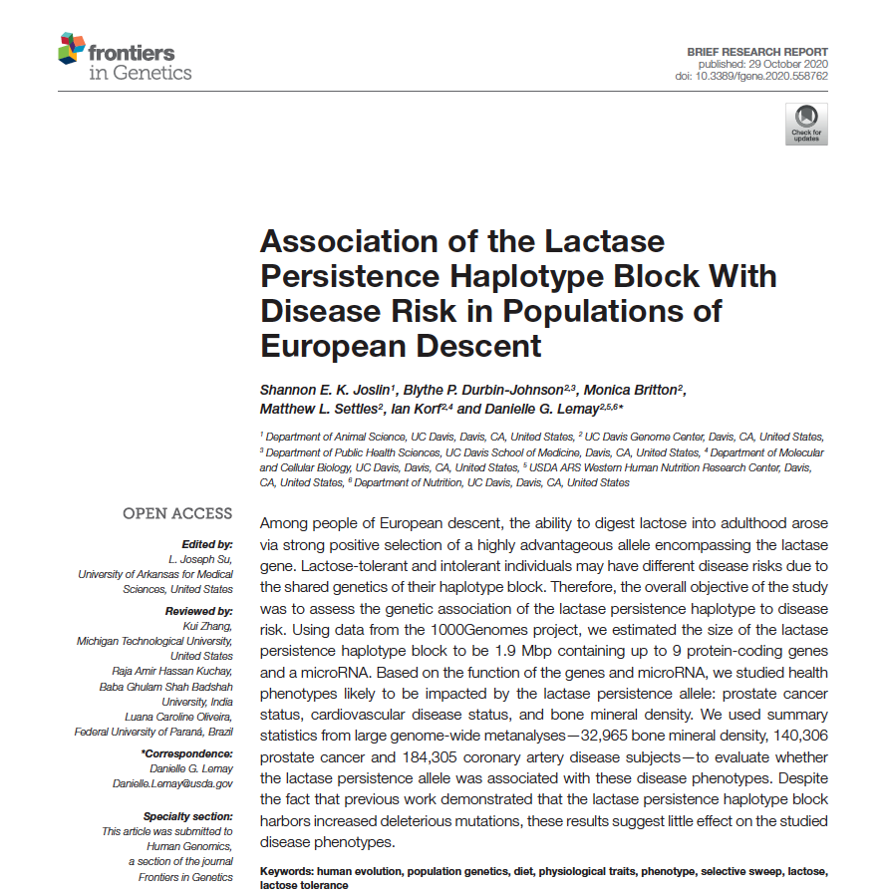

Slide 13
Linkage Disequilibrium

Slide 14
Enrichment Test

